Slide 1
OpenCV Performance Evaluation
Group d

Slide 2
Project Goal: Achieved ✅
Goal: Benchmark and analyze performance of 4 different programming languages when executing OpenCV operations on Raspberry Pi.✅
Functions tested: - Blue to Gray color conversion
- Image sharpening
- Image resizing
- Image cropping
- Histograms
Platform: Raspberry Pi Model B (8GB)
Languages: - C++
- Python
- Golang
- Rust

Slide 3
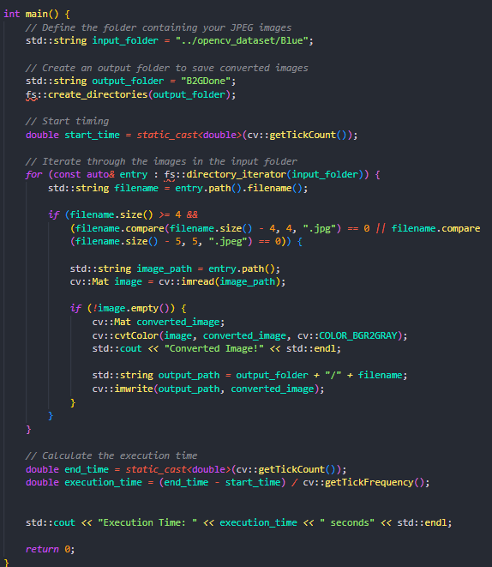
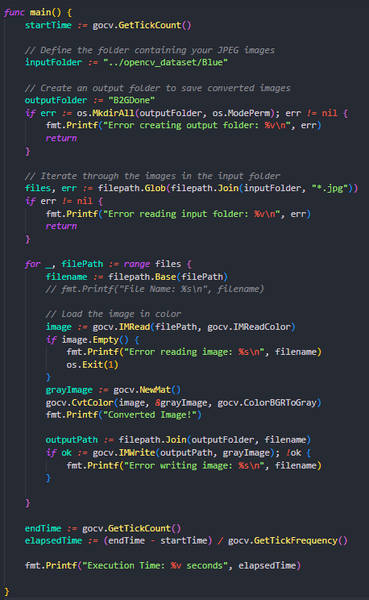
Ensuring Same Flow of Instructions
C++ Code as reference
The C++ code was one of the first we installed, making sure we could create a fairly simple task for replication across languages.
Calculating Execution Time:
GetTickCount() for before and after desired execution.
Difference /(getTickFrequency)

Slide 4
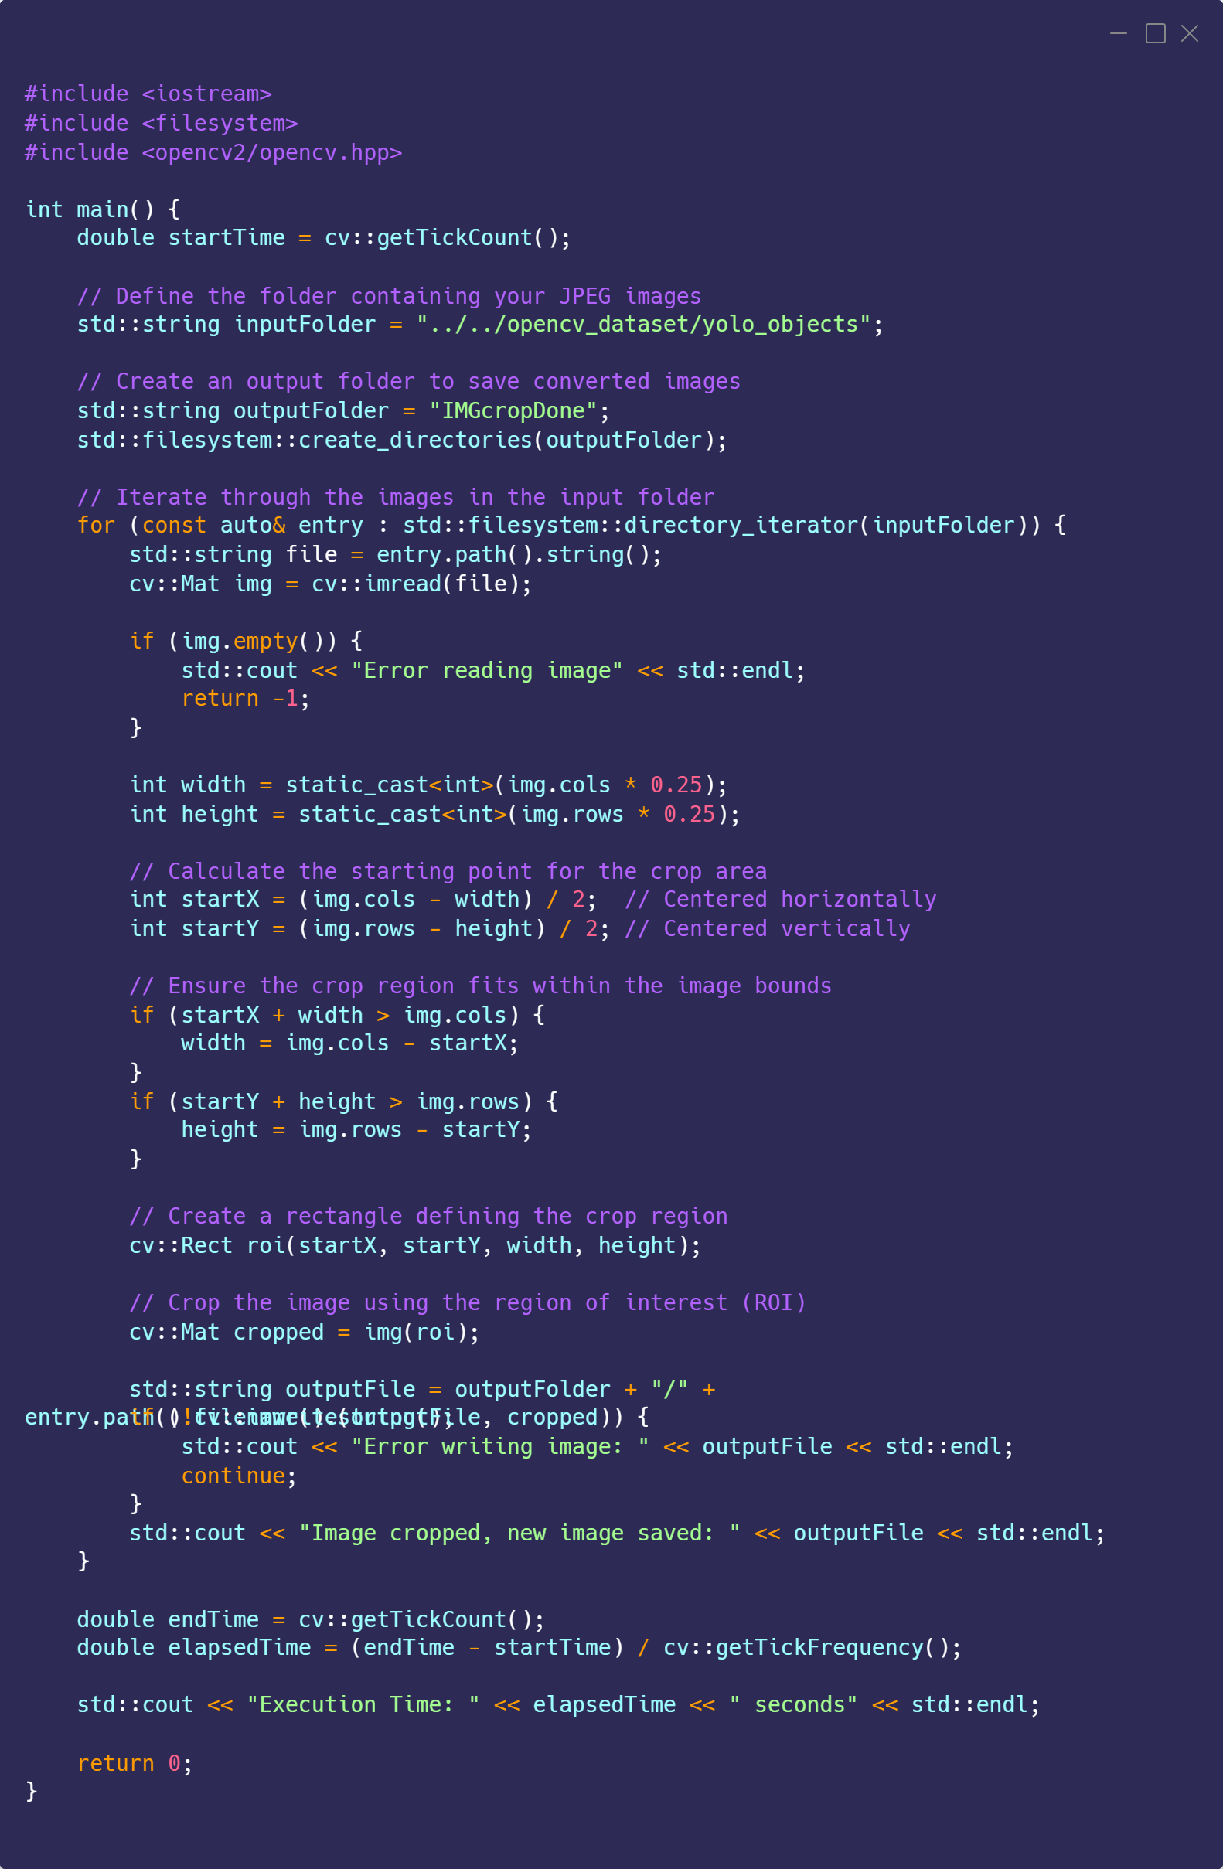
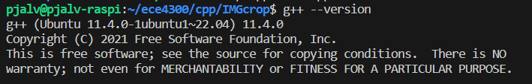
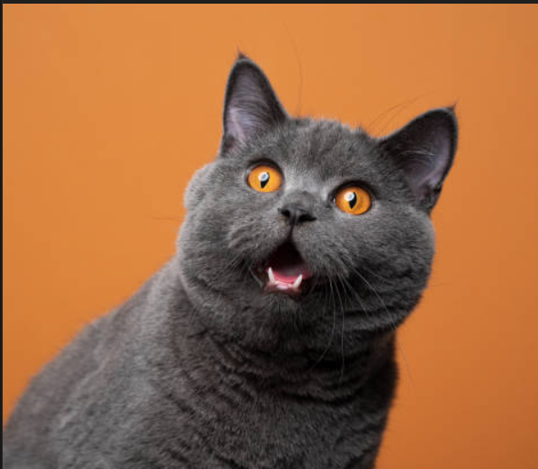

C++:IMG crop example

Slide 5
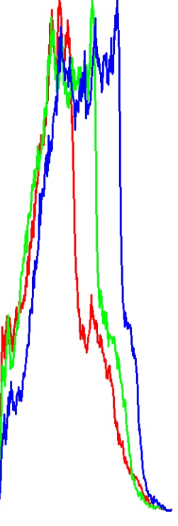
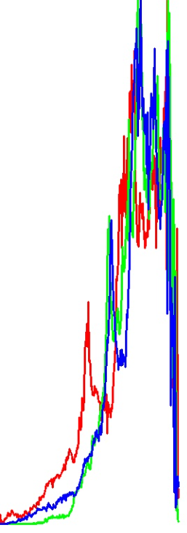
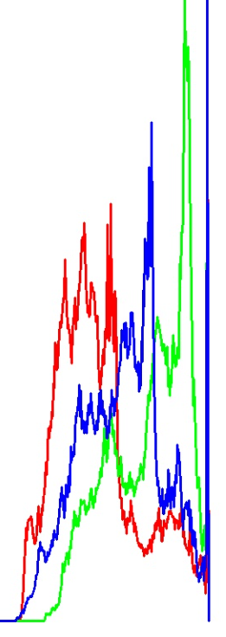
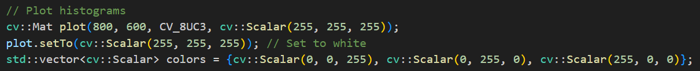
Python
• OpenCV provided by prebuilt Python package "opencv-python"
• Used version 4.8.1.78
• Syntax is simpler than some languages
• Uses additional library "numpy" for mathematical operations

Slide 6
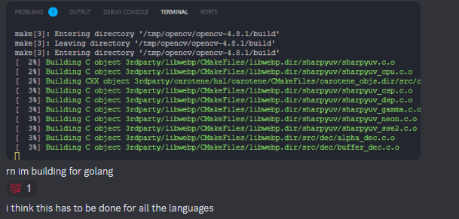
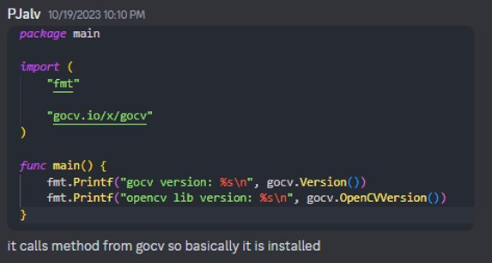
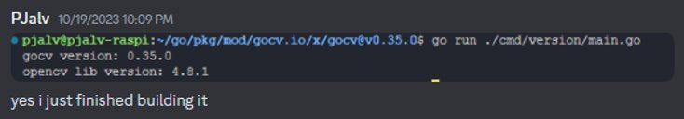
Golang
Provides multiple ways of installing
From ubuntu package
From developer source
OpenCV on Go is the package "GoCV"
Released Dec. 2017 (Latest commit Oct)
Experience:
Cloning git repo and running make file is simple, but the linking and building of C objects for Go use took some time.
Once installed it was simple to get a working program.
Errors on runtime were also helpful to ensure functions were as similar as the c++ reference library

Slide 7
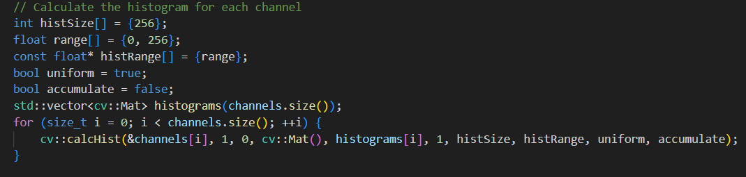
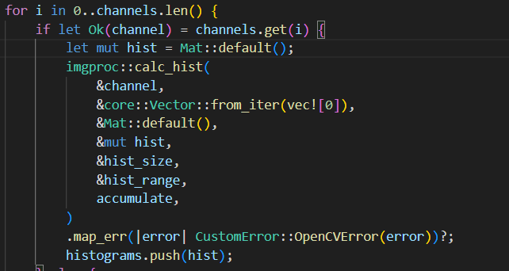
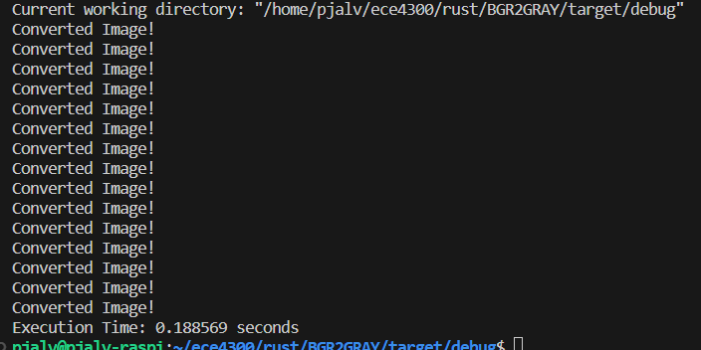
Rust
Inconsistent functions (name/# of arguments/etc)
Not easy to use opencv in Rust
Errors were helpful

Slide 8
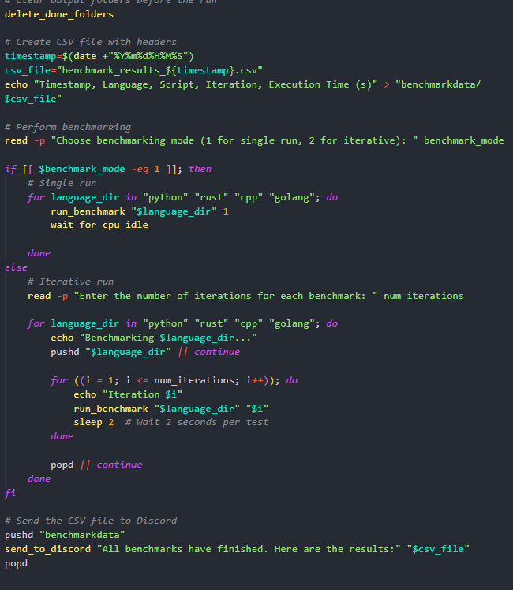
Shell Script
Created to help perform benchmarks quicker and in most repeatable way.
Functions like wait_for_cpu_idle help make sure one test's resources are not affecting the subsequent test.
"*.sh" files created in each language top directory, contains command to execute scripts
Can be expanded;
Take data and have automatic chart creation.

Slide 9
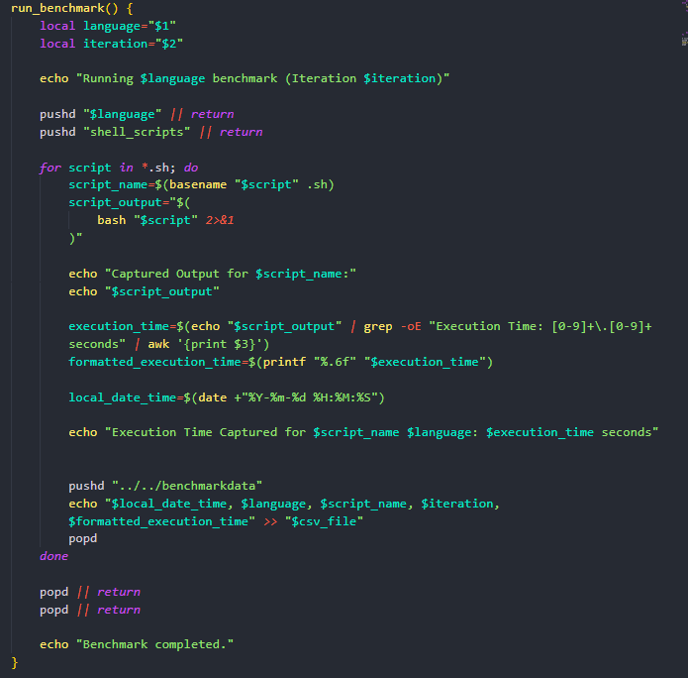
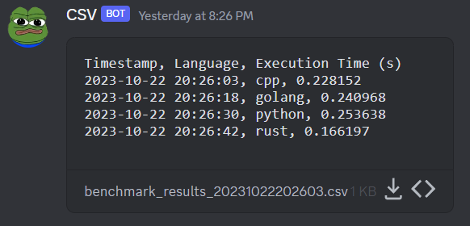
Data Collection Process
run_benchmark function:
Is made to run each of language's script(s)
Takes 2 arguments (language & num of iterations)
Incorporates pushd and popd commands:
Directory stack system used instead of "cd & cd .."
All scripts print execution time in same format:
"Execution Time: [exec. Time here] seconds"
Regular Expression is used to parse for value.
Data is then saved onto csv.
When all desired tests are ran, csv is sent to discord channel.

Slide 10
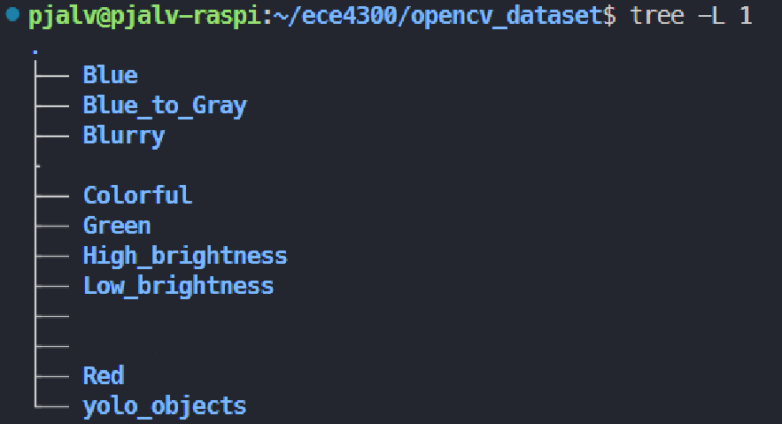
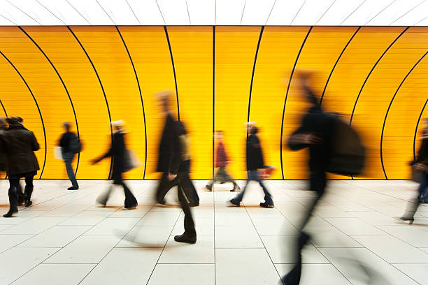



OpenCV dataset
15 Images of:
Blue
Red
Green
Multi-color
Blurry
High brightness
Low brightness
Used:
Blue
Blurry
yolo_objects

Slide 11
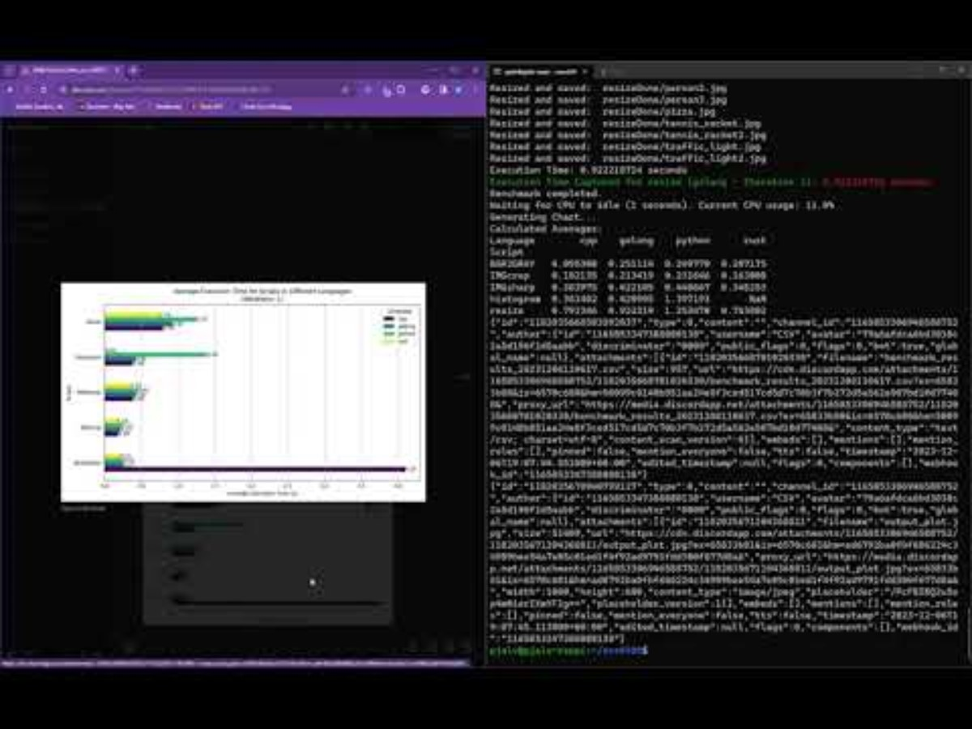

Slide 12
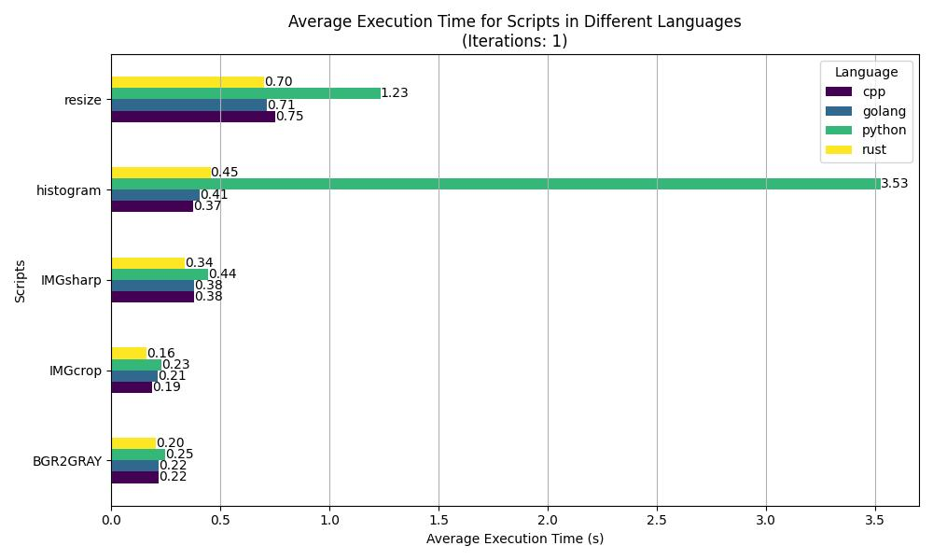
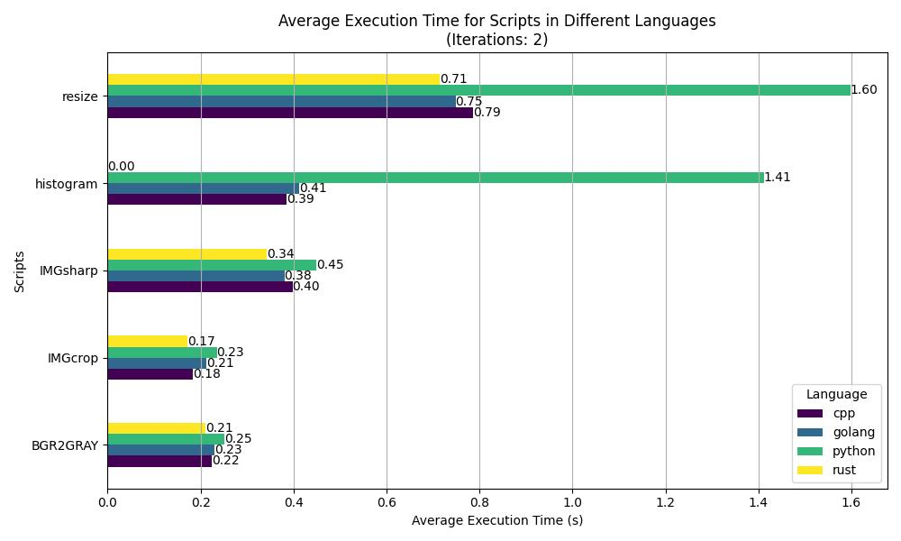
Benchmark Results

